Slide 1
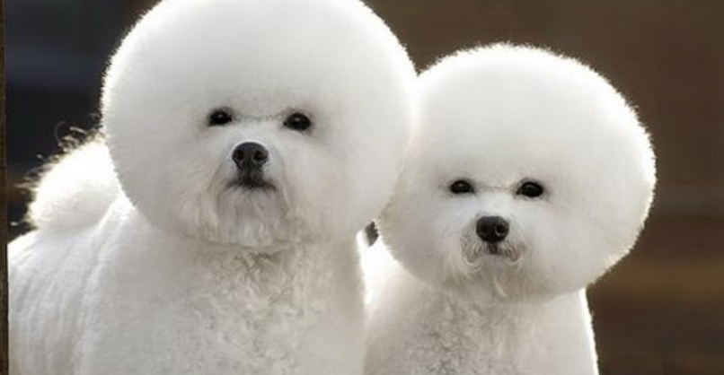
Starting a Fashion Dog Brand
The Future Of Pet Care
Bleiu April 2023

Slide 2
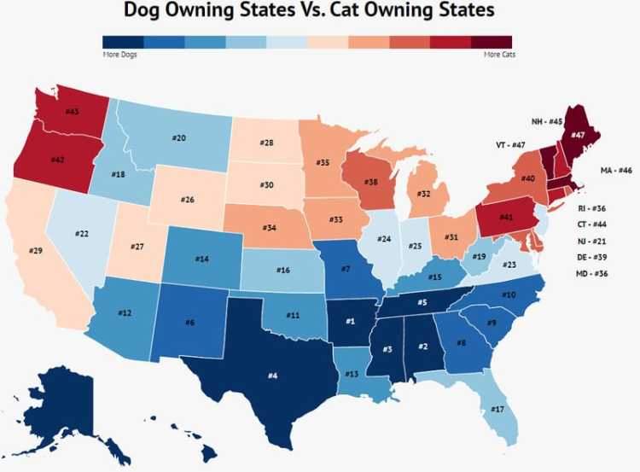




27 out 50 States
FINDING A NICHE
Caption

Slide 3

The Facts
Arkansas is #1 for Dog ownership
38.4% of American households own a dog.
In 2018, Americans owned 76,811,305 dogs.
40% of United States households own at least 1 pet dog.
Dog ownership increased by nearly 11% during the COVID-19.
The USA has the most dogs in the world per capita

Slide 4

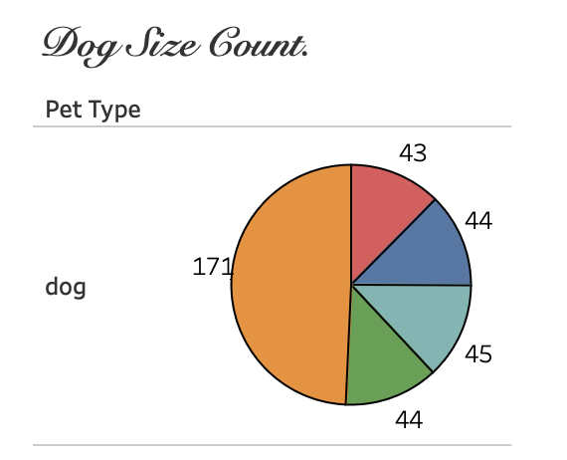

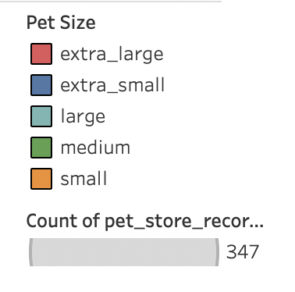
What Size Dog?
FINDING A NICHE

Slide 5

47% of dog owners have small dogs.
Small dogs remain the most popular size
Guess What!?

Slide 6
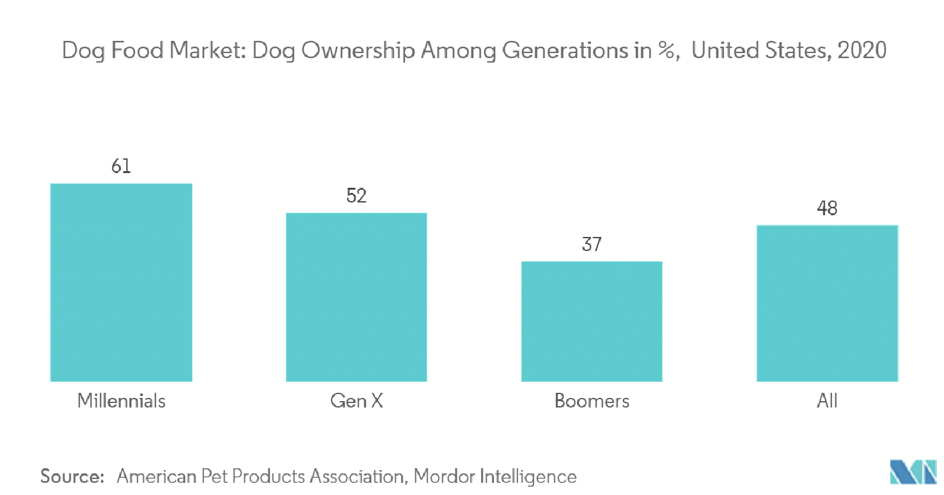
Who Owns Small Dogs?
27 – 42
43 – 58
59 – 68

Slide 7

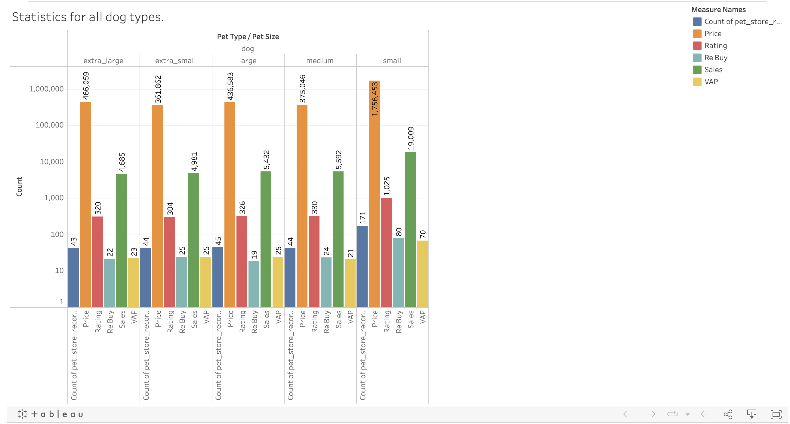

Statistically Small Dogs are Spoiled by Millinnials!
Parenthood initiation
Creating cultural norms at home,
Companion
Emotional healing

Slide 8

Yay! We Found Our Niche and Target Market!
Millennial Small Dog Owners

Slide 9





Its a Fact..
The global pet clothing market size was USD 5.01 billion in 2020. North America 1.7 Billion in 2020

Slide 10

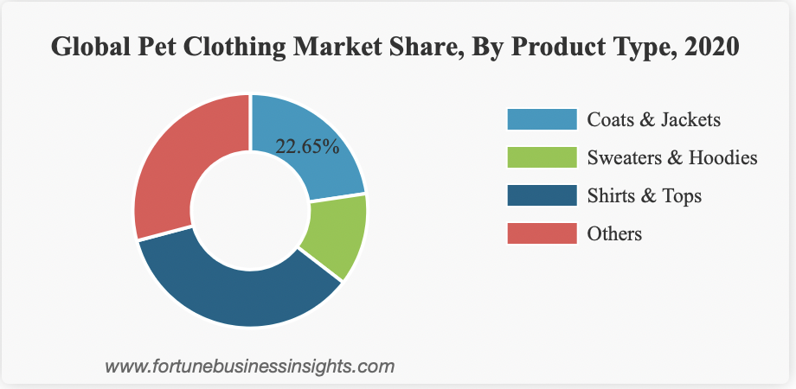
Fashion Forward Focus
11.33%
27.35%
38.68%

Slide 11

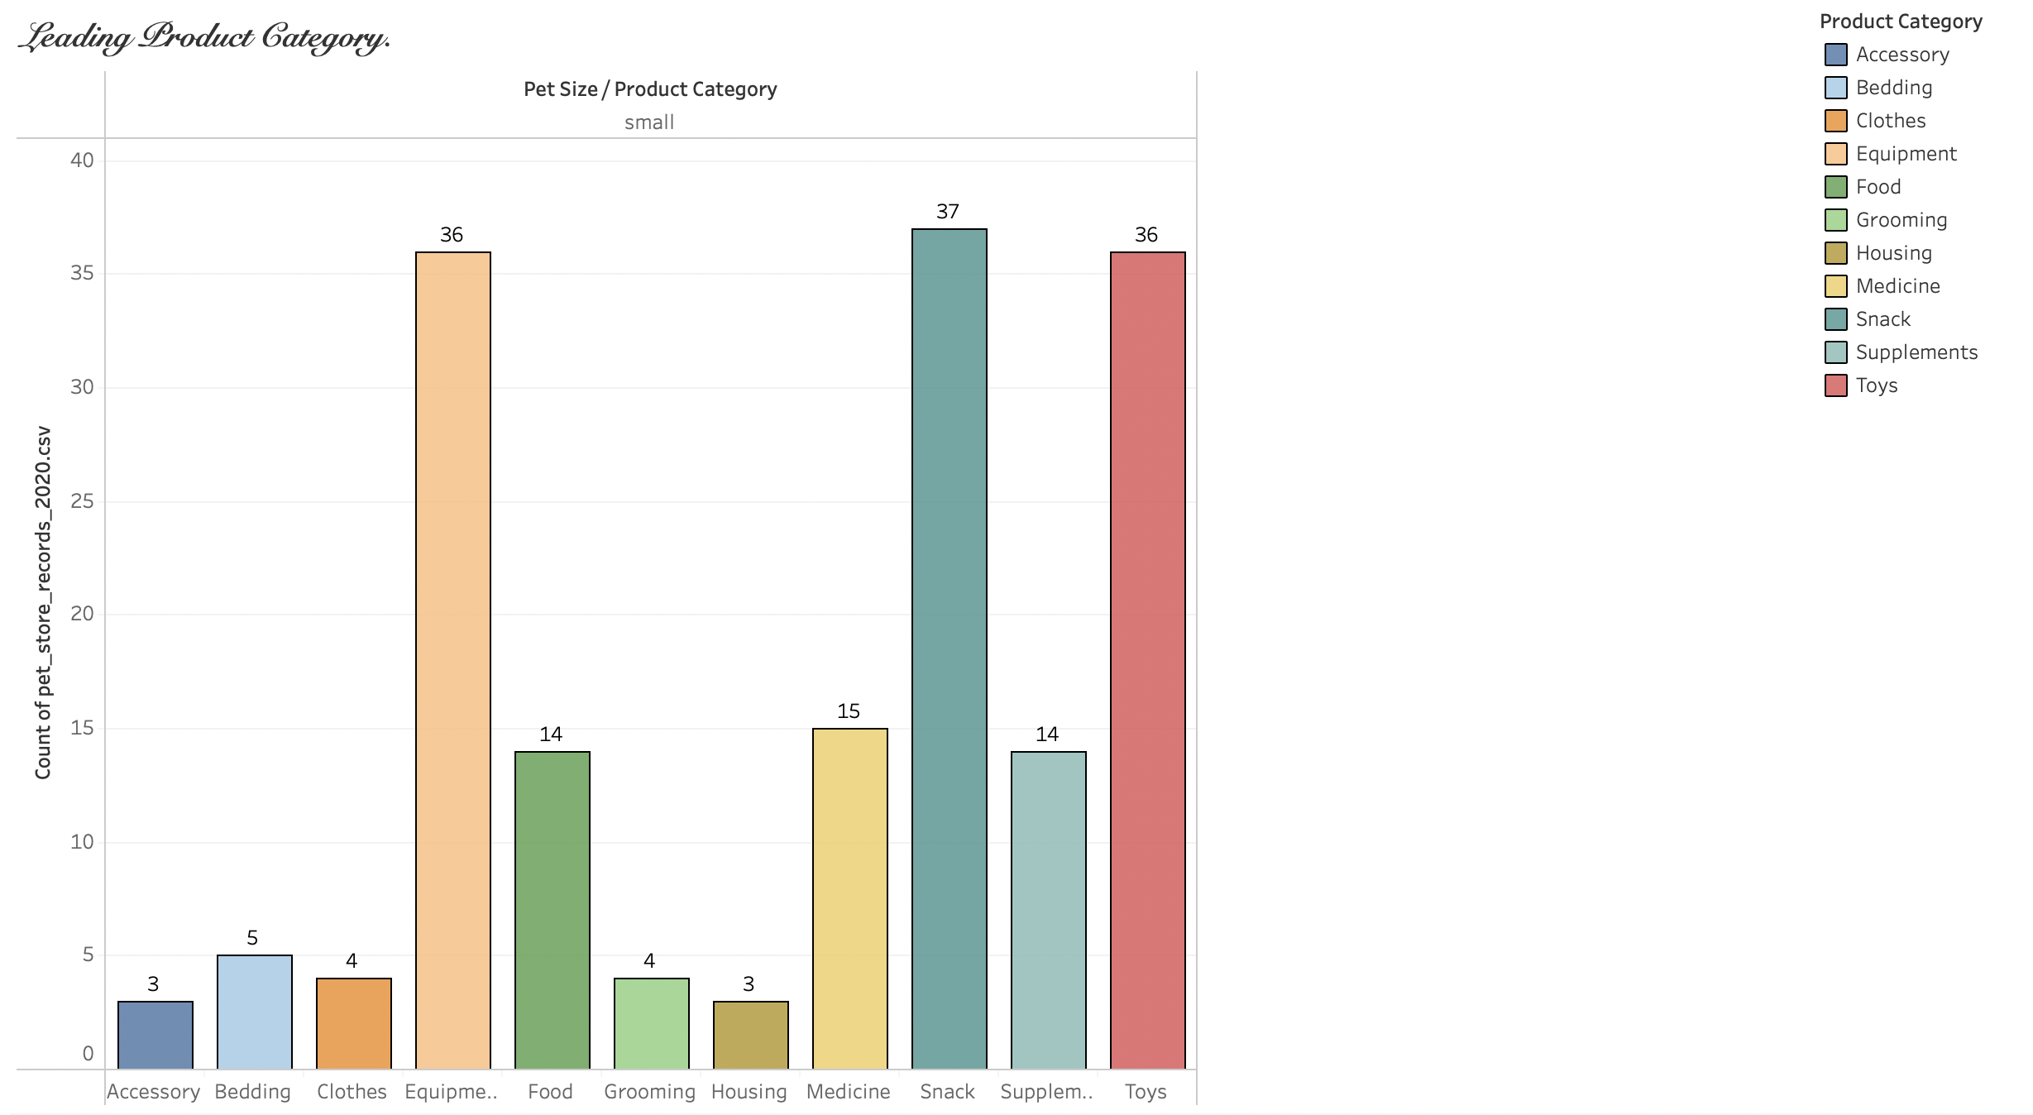
Leading Dog Products in Store

Slide 12

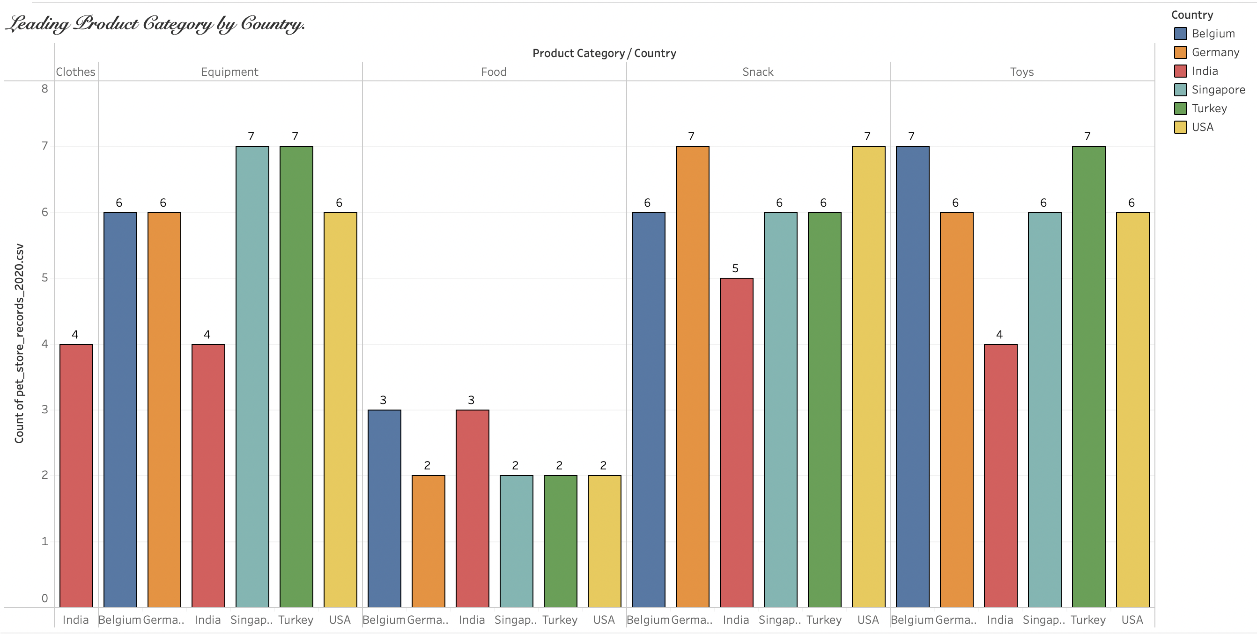

Slide 13

What Can we do with this information?
Add these products to our store
Giveaway loyalty gifts
Make sure products originate from these regions

Slide 14

What country has the highest product rating and sales for small dogs?

Slide 15

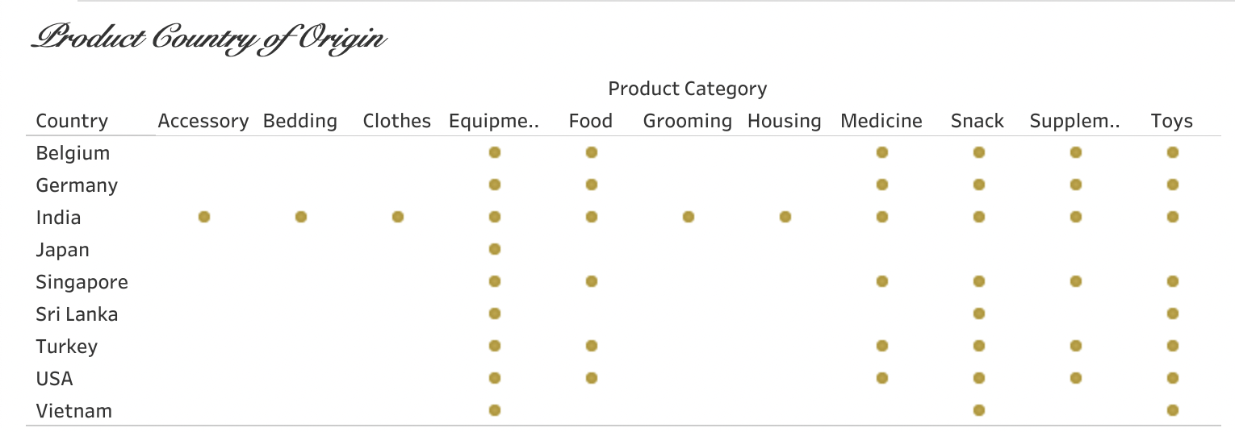
Sourced /Derivation
INDIA

Slide 16

Facts about India..
India’s pet care market is growing at 13.9% annually, making it one of the fastest-growing pet care markets in the world.
It is estimated that India’s pet care industry will reach $800 million by 2025.
By 2022, India’s pet care industry was projected to reach $490 million.
Dogs are the most popular pet in India, with an estimated 31 million pet dogs projected by the end of 2023.
= Quality.

Slide 17

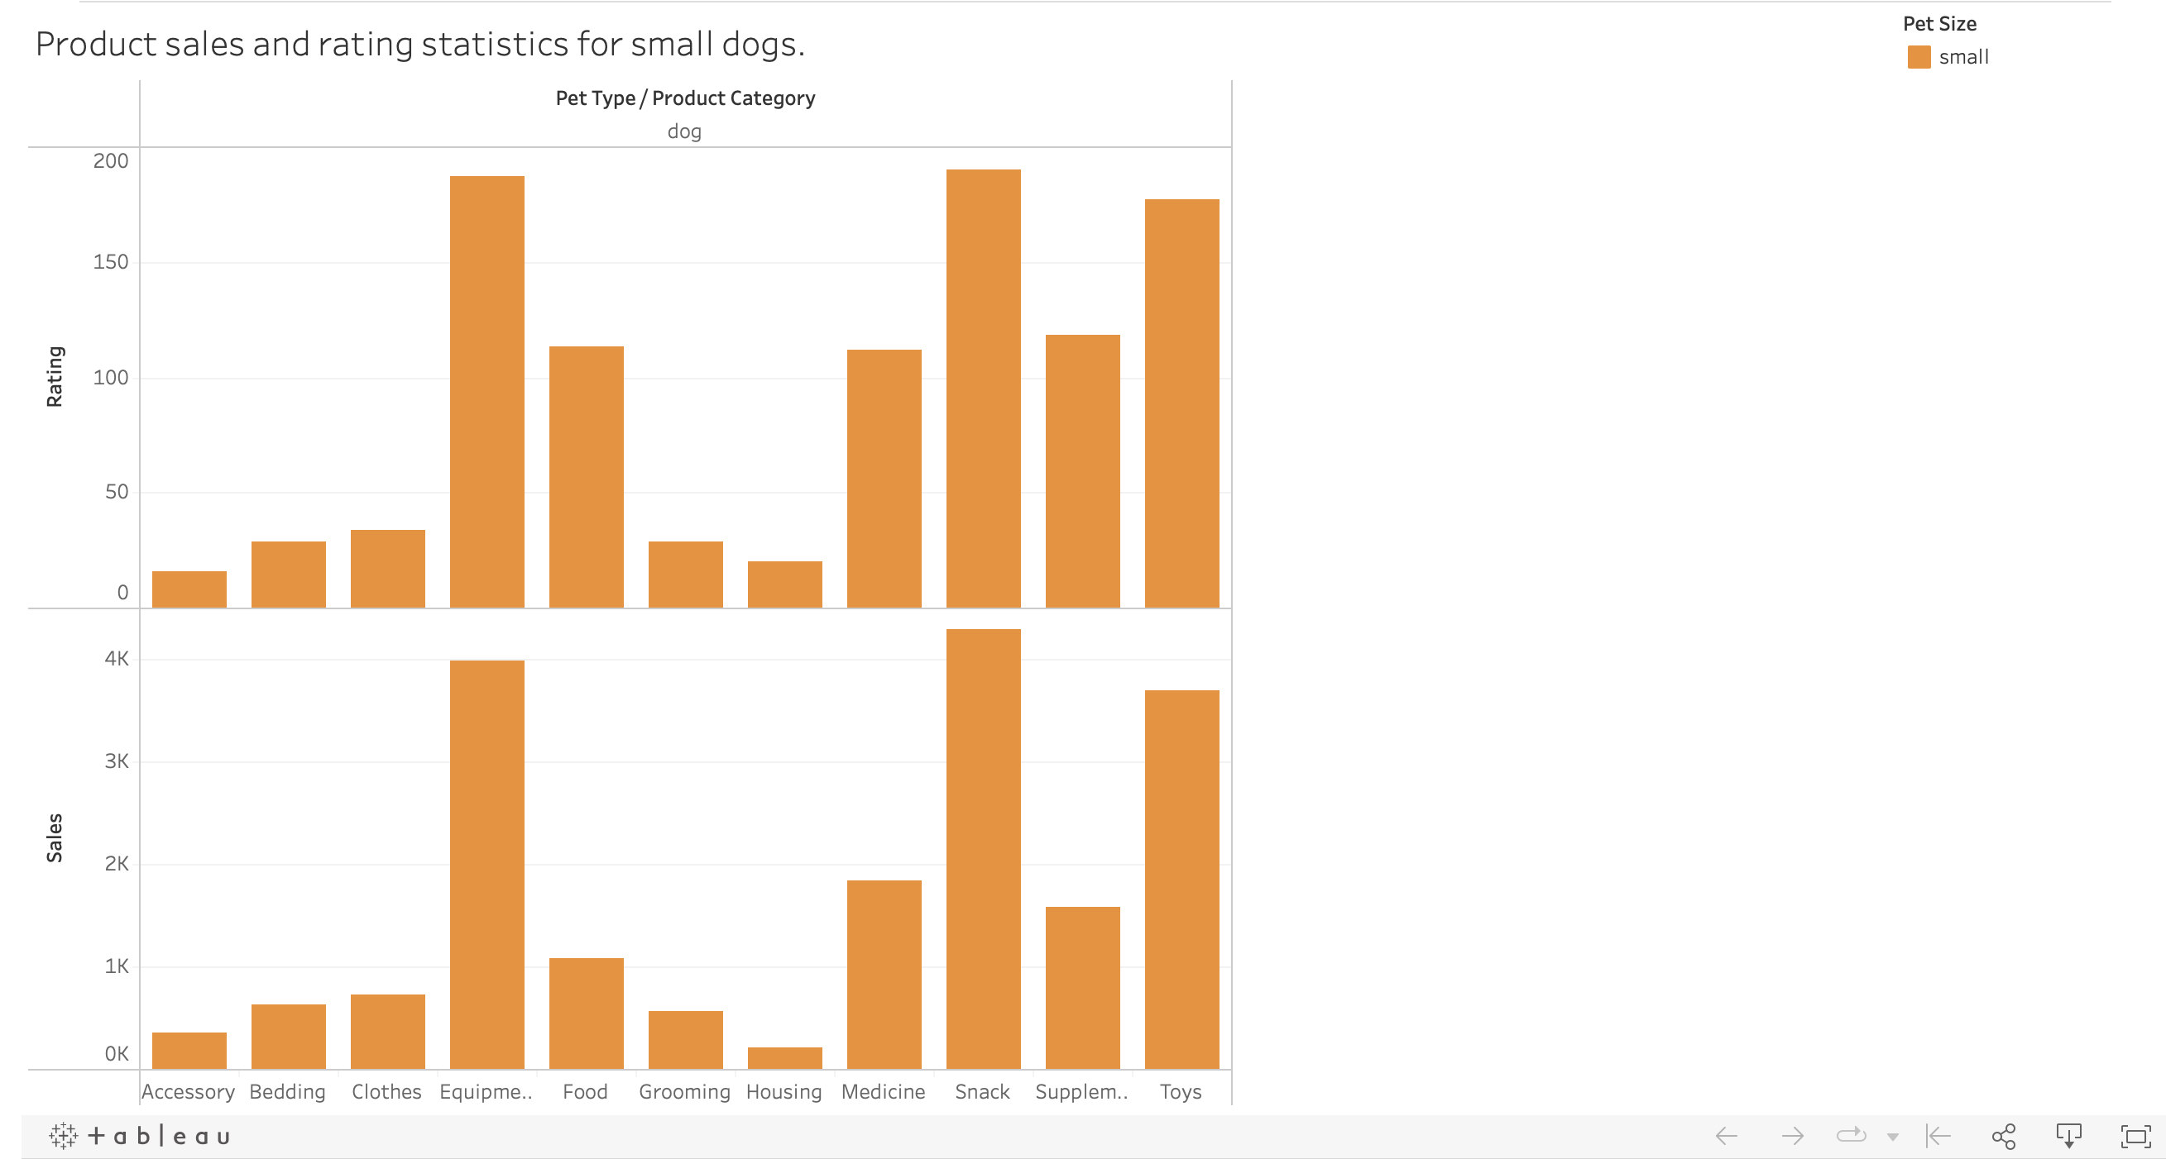
Is there a relationship here?

Slide 18

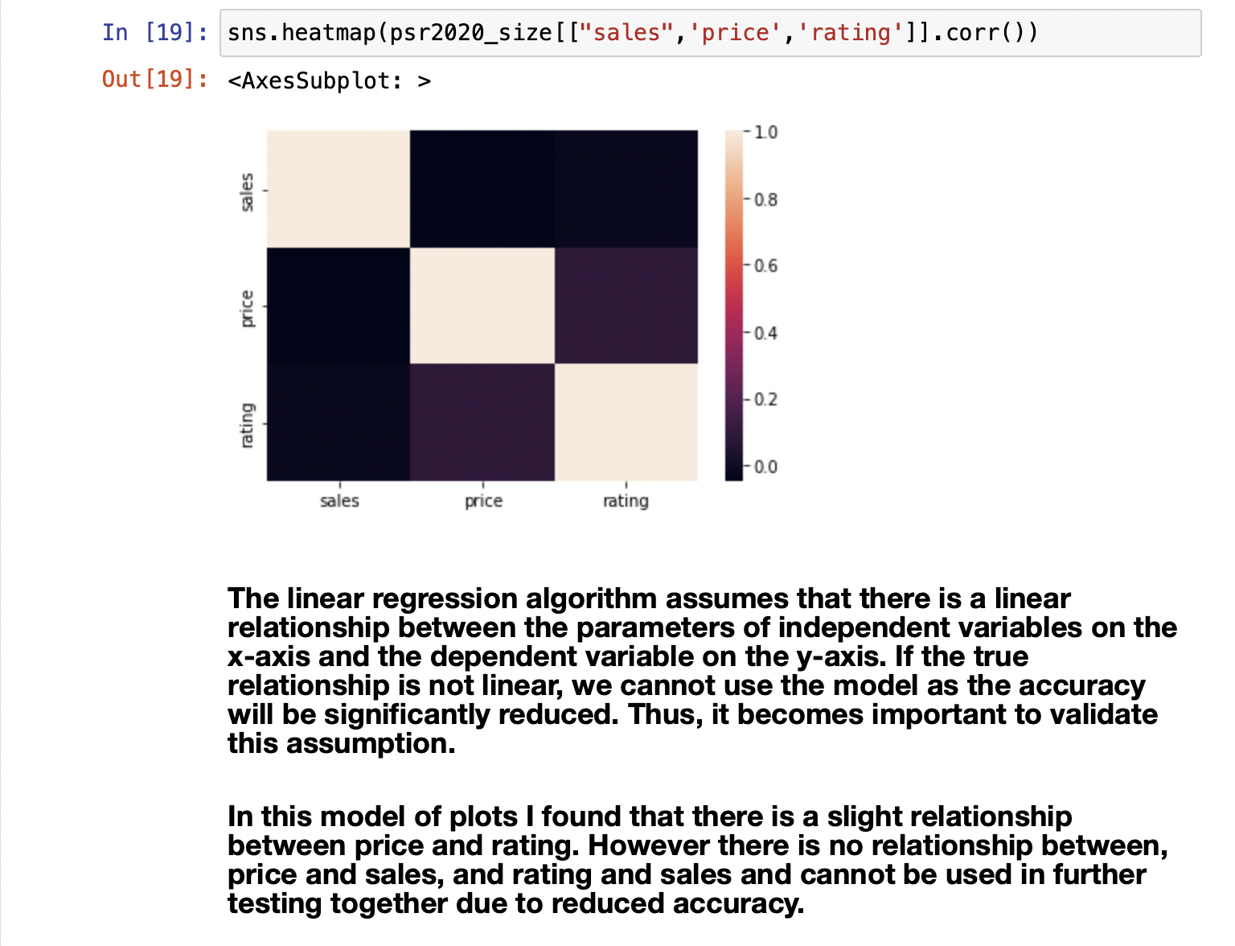

Slide 19

Does the product rating determine which product has the highest sales for small dogs?

Slide 20

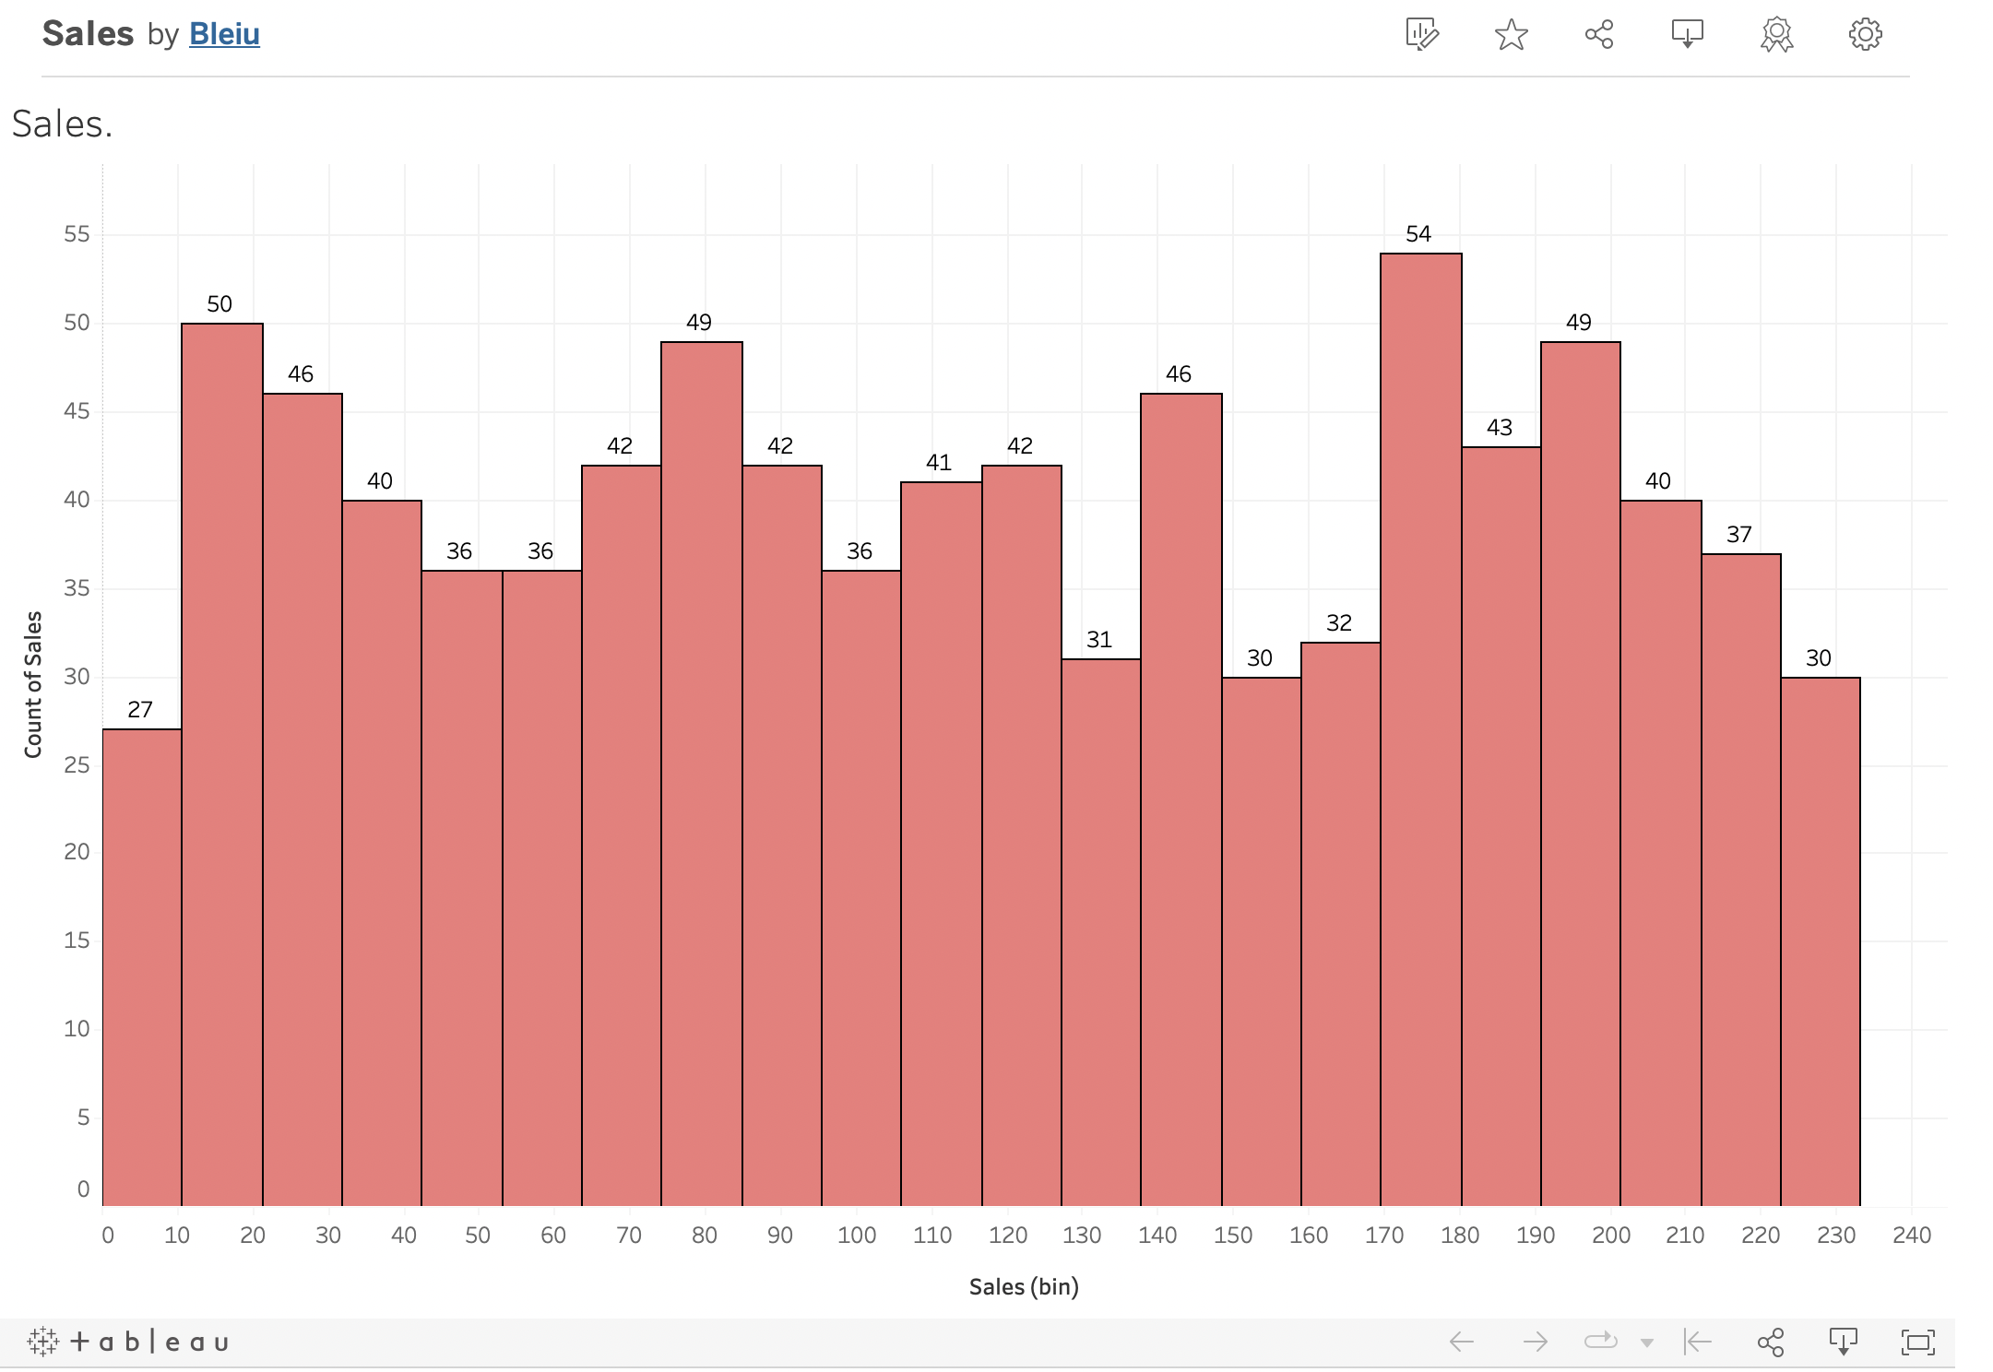


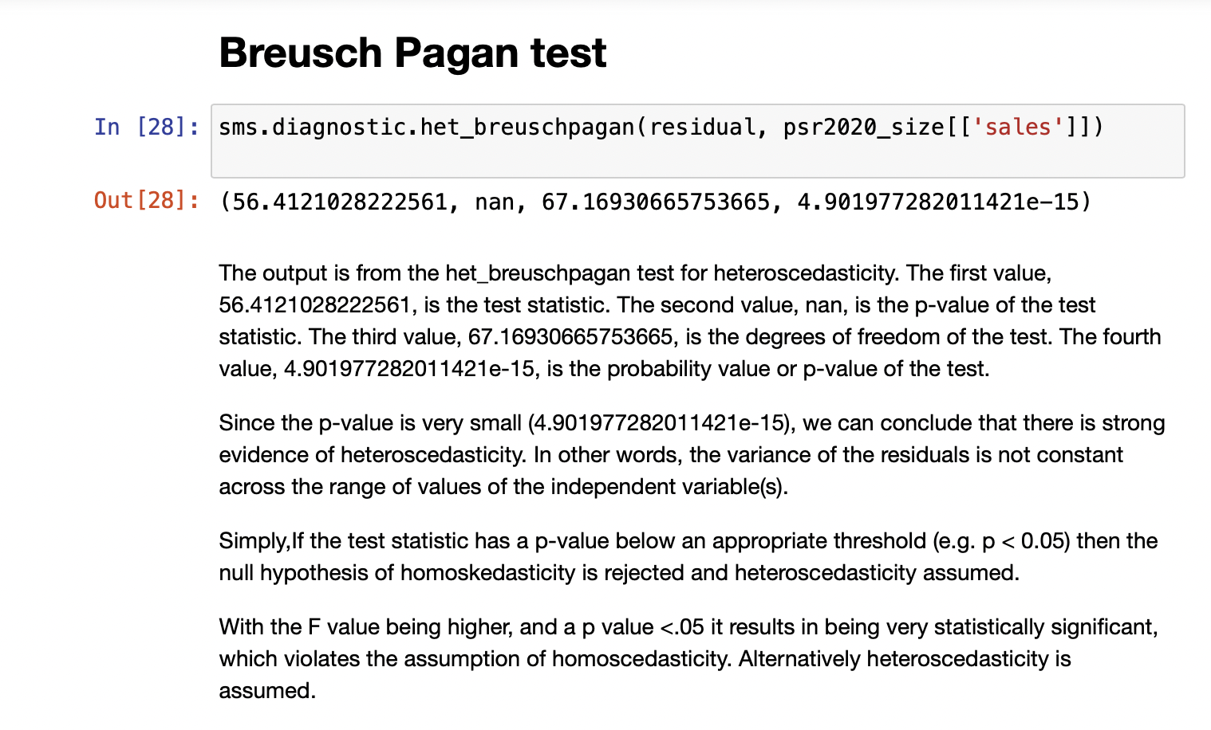

Let’s take a look at Sales
Heteroscedasticity is present = not constant over time
This is normal..

Slide 21

Reasons Why?
A. Marketing B. Store popularity C. Size of store ( less product variety) D. No access to latest products

Slide 22
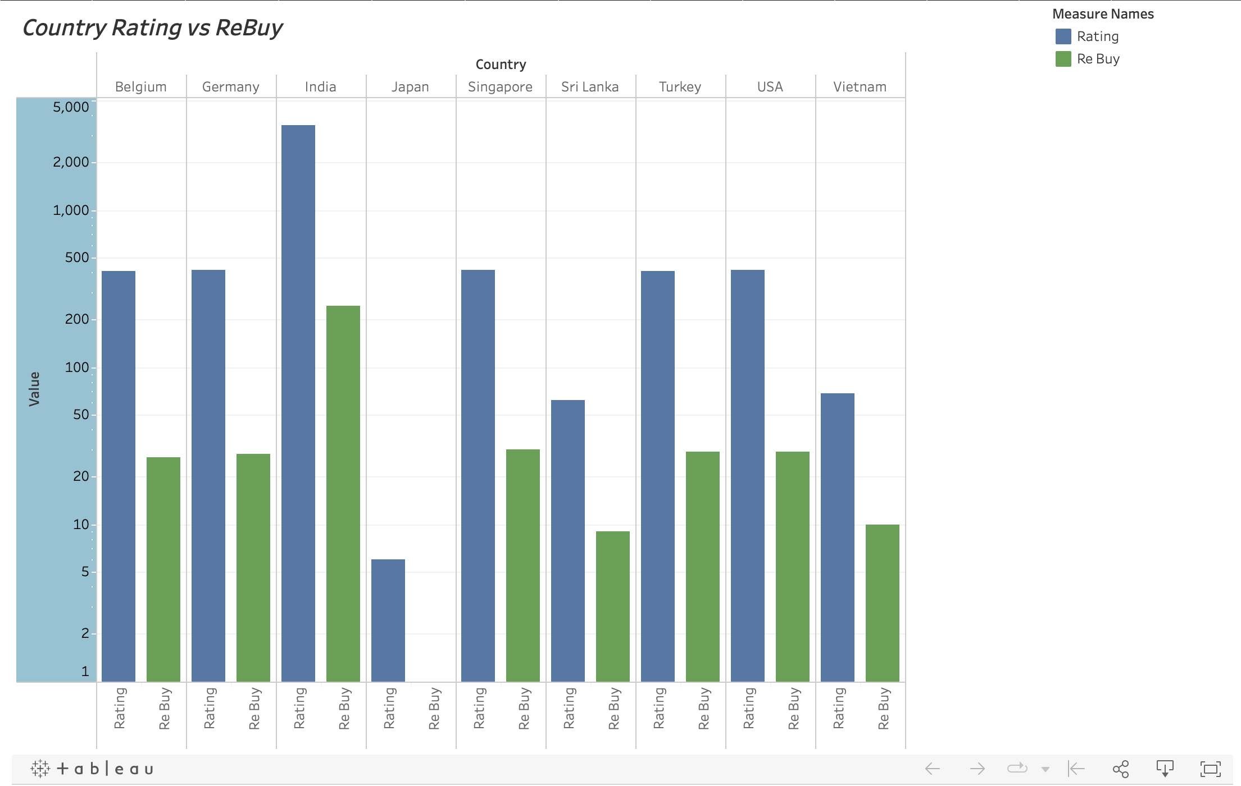

As the rating decreases the rebuy is also affected and declines.
As the rating increases the rebuy increases
Caption

Slide 23

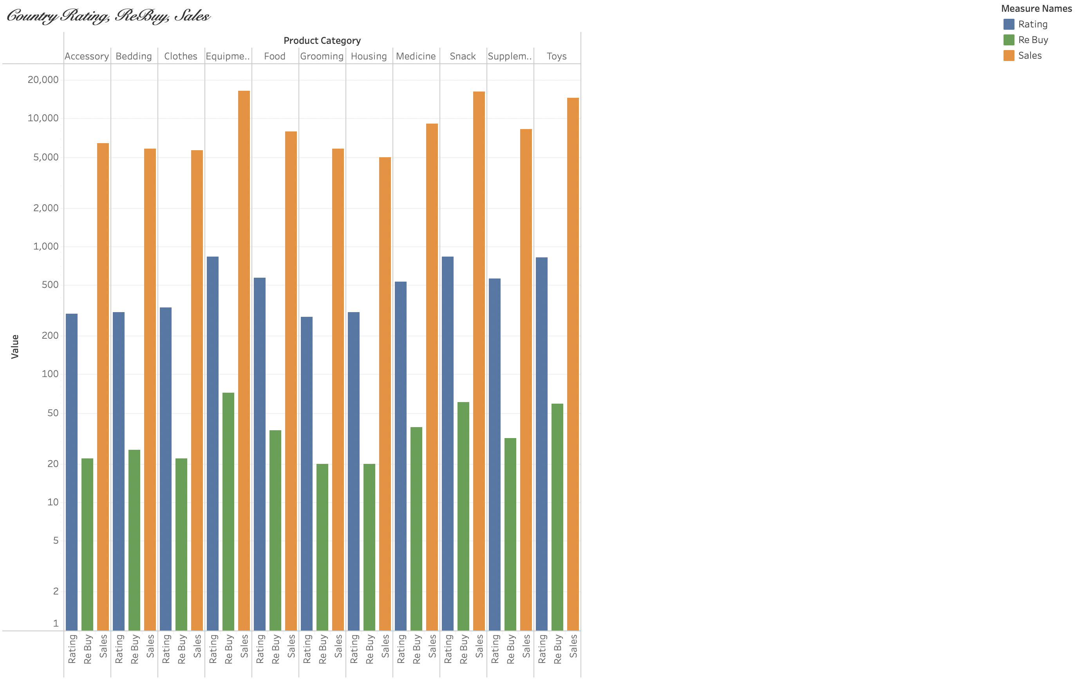

Rating has an affect on the rise and decline of Sales but the affects are very subtle. Rebuy products are highest for products with highest sales records.

Slide 24
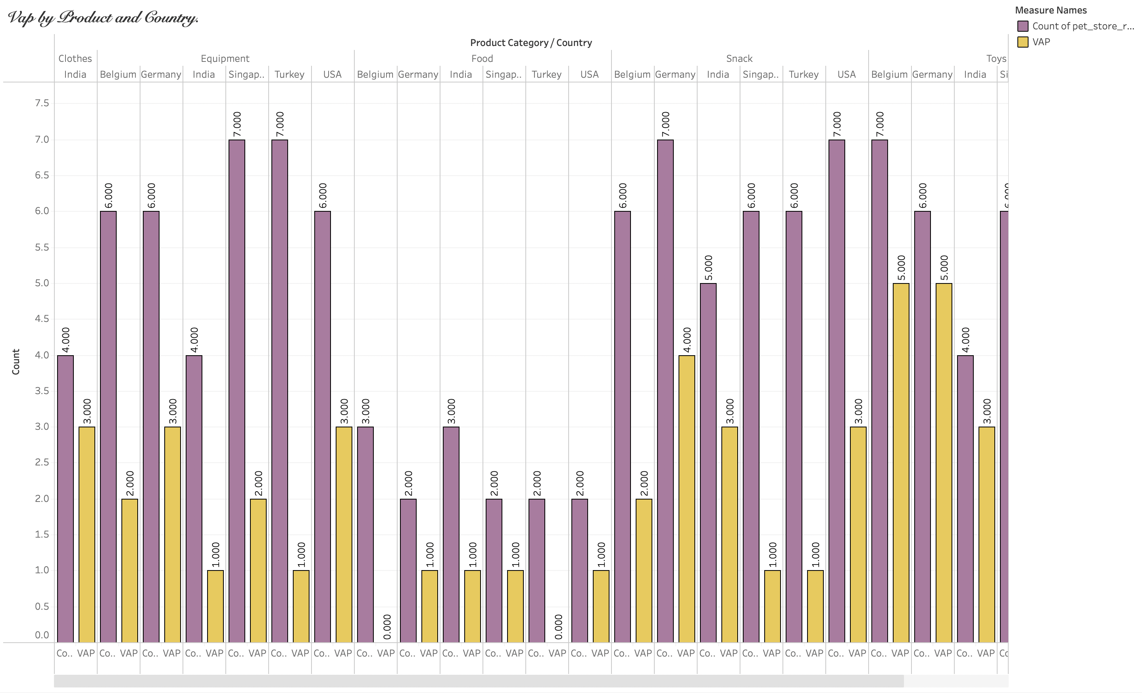
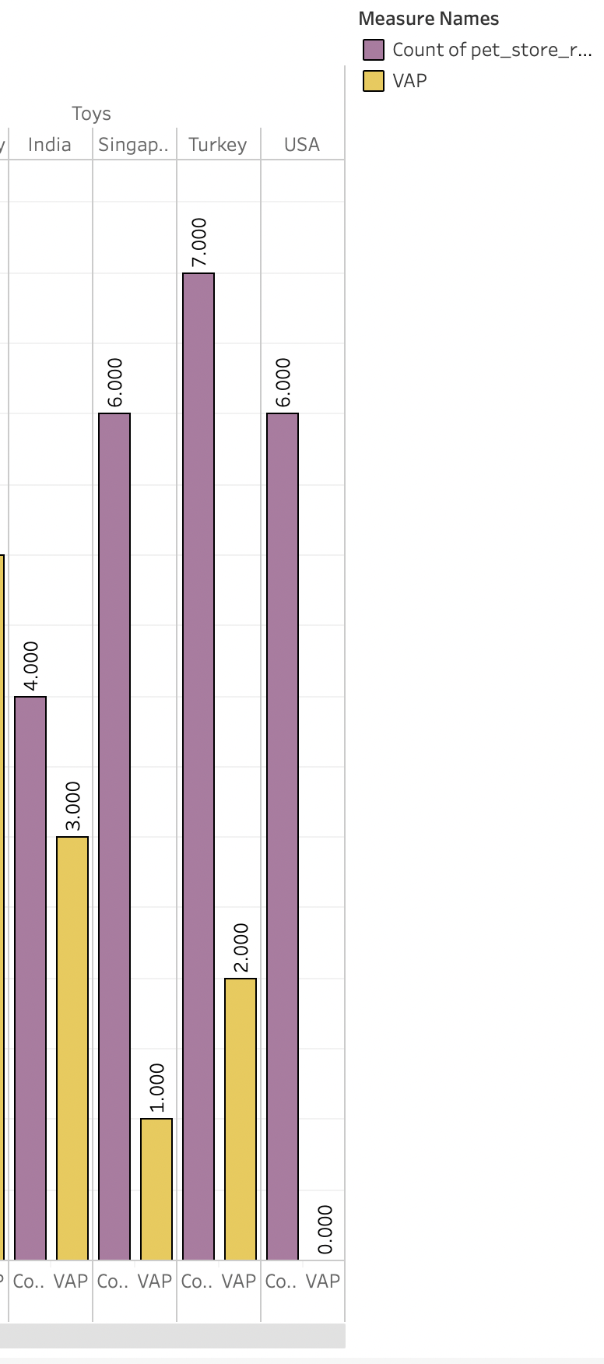

Is there A Dog-tor in the house?
Chronic Diseases Skin Irritants Allergies
Safety First ! Vap

Slide 25

In Conclusion.. We learned..
Niche: small dogs owned by millennials
Source of the products matter: Quality = Ratings Sales
(Results may vary due to external/internal components)
ratings and sales = Rebuys
Price doesn’t matter: Quality/Quantity
Safety First: Attentive to contents, ingredients, or material and how they affect your pet

Slide 26

Questions?
End
The

